Slide 1




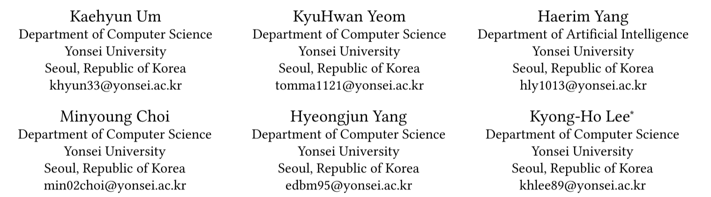



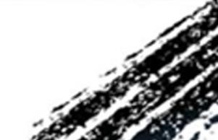

ATAI
Advanced Technique of Artificial Intelligence
ATAI
ChongqingUniversity _{AdvancedTechniqueof}
of Technology Artificial Intelligence
Chongqing University of
Technology
Chongqing University ^{ATAI}
_{of Technology} Advanced Techniqueof
Artificial Intelligence
Chongqing University of Technology
Chongqing University of Technology
RPO-RAG: Aligning Small LLMs with Relation-aware Preference
Optimization for Knowledge Graph Question Answering
Code: https://github.com/KaeHyun/RPO-RAG
——WWW 2026
Reported by Xiang Zhang
1

Slide 2
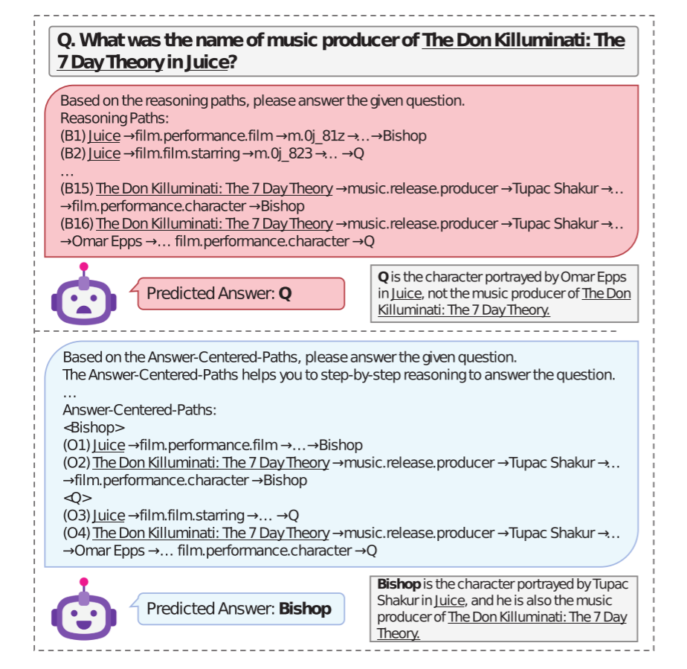
ATAI
Advanced Technique of Artificial Intelligence
ATAI
ChongqingUniversity _{AdvancedTechniqueof}
of Technology Artificial Intelligence
Chongqing University of
Technology
Chongqing University ^{ATAI}
_{of Technology} Advanced Techniqueof
Artificial Intelligence
Chongqing University of Technology
Chongqing University of Technology
Motivation
(1) First, their path sampling method for training data construction is typically semantics-unaware, relying on shortest-path heuristics that often select paths inconsistent with a query’s intent.
(2) Second, there exists a weak alignment between the retrieved paths and the reasoning objectives of LLMs.
(3)While large-scale models (e.g., GPT-4) can partially offset retrieval noise using their extensive parametric knowledge, small LLMs (1–8B parameters) are far more sensitive to both retrieval noise and ungrouped path evidence due to their limited reasoning capacity.

Slide 3
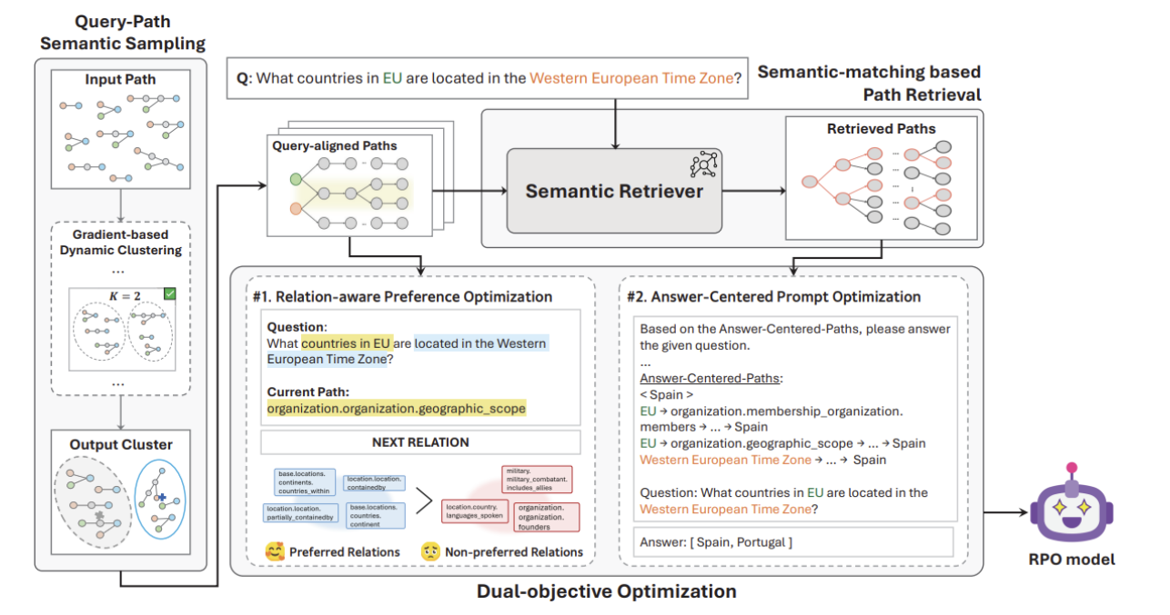
ATAI
Advanced Technique of Artificial Intelligence
ATAI
ChongqingUniversity _{AdvancedTechniqueof}
of Technology Artificial Intelligence
Chongqing University of
Technology
Chongqing University ^{ATAI}
_{of Technology} Advanced Techniqueof
Artificial Intelligence
Chongqing University of Technology
Chongqing University of Technology
Overview

Slide 4
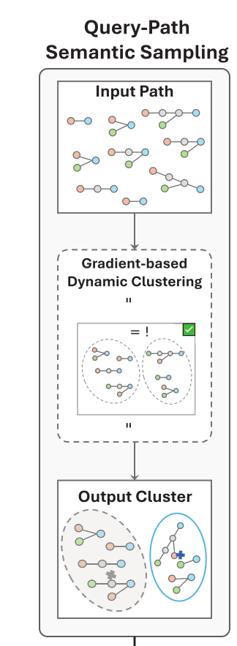
ATAI
Advanced Technique of Artificial Intelligence
ATAI
ChongqingUniversity _{AdvancedTechniqueof}
of Technology Artificial Intelligence
Chongqing University of
Technology
Chongqing University ^{ATAI}
_{of Technology} Advanced Techniqueof
Artificial Intelligence
Chongqing University of Technology
Chongqing University of Technology
Method
First, the input sequence of image patches (where the image is divided into many small patches and fed into the model sequentially) is partitioned into windows of different sizes, with varying sparsity rates used to determine the sparse connectivity pattern of the attention mechanism. Within each window, the attention weight matrix is obtained through sparsification. Finally, the three sparse attention patterns at different scales are fused via weighted integration, forming the final multi-scale dilated attention pattern.

Slide 5

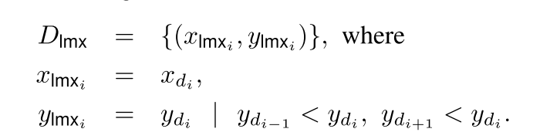
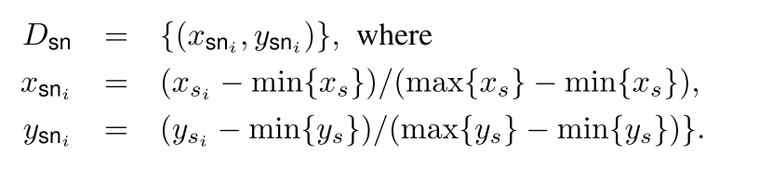
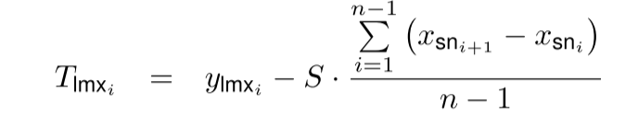
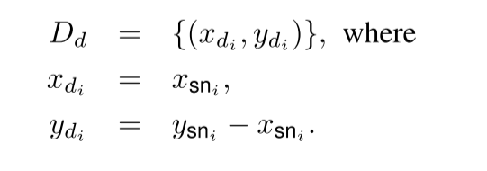
ATAI
Advanced Technique of Artificial Intelligence
ATAI
ChongqingUniversity _{AdvancedTechniqueof}
of Technology Artificial Intelligence
Chongqing University of
Technology
Chongqing University ^{ATAI}
_{of Technology} Advanced Techniqueof
Artificial Intelligence
Chongqing University of Technology
Chongqing University of Technology
Method

Slide 6
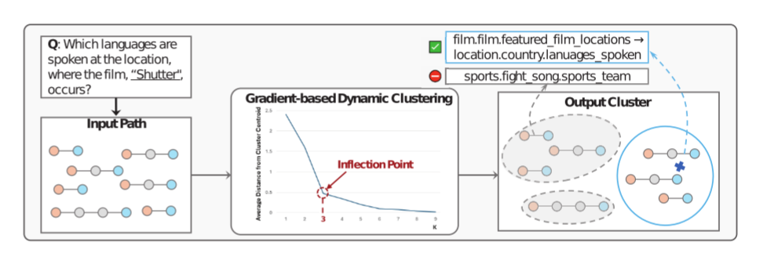



ATAI
Advanced Technique of Artificial Intelligence
ATAI
ChongqingUniversity _{AdvancedTechniqueof}
of Technology Artificial Intelligence
Chongqing University of
Technology
Chongqing University ^{ATAI}
_{of Technology} Advanced Techniqueof
Artificial Intelligence
Chongqing University of Technology
Chongqing University of Technology
Method

Slide 7

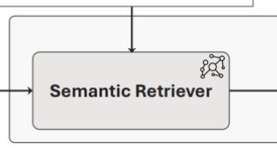
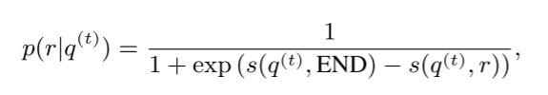

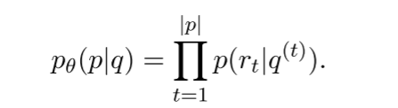
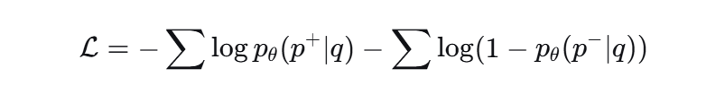
ATAI
Advanced Technique of Artificial Intelligence
ATAI
ChongqingUniversity _{AdvancedTechniqueof}
of Technology Artificial Intelligence
Chongqing University of
Technology
Chongqing University ^{ATAI}
_{of Technology} Advanced Techniqueof
Artificial Intelligence
Chongqing University of Technology
Chongqing University of Technology
Method

Slide 8

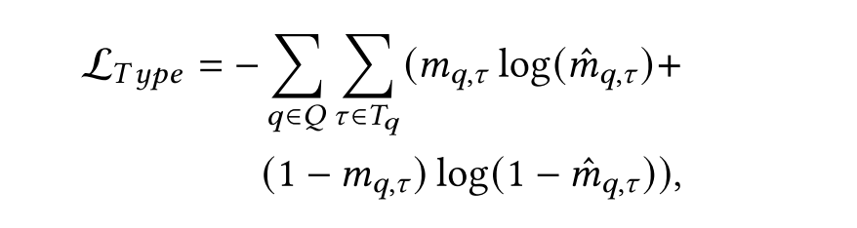
ATAI
Advanced Technique of Artificial Intelligence
ATAI
ChongqingUniversity _{AdvancedTechniqueof}
of Technology Artificial Intelligence
Chongqing University of
Technology
Chongqing University ^{ATAI}
_{of Technology} Advanced Techniqueof
Artificial Intelligence
Chongqing University of Technology
Chongqing University of Technology
Method
where 𝑚𝑞,𝜏 is a labeled entity type score. After training, we use the top-5 prediction result to exclude paths whose terminal entity is inconsistent with the predicted types.

Slide 9
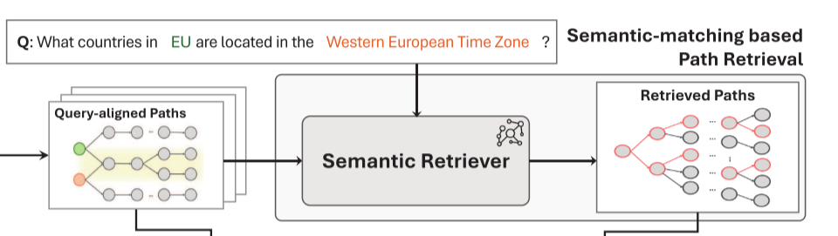
ATAI
Advanced Technique of Artificial Intelligence
ATAI
ChongqingUniversity _{AdvancedTechniqueof}
of Technology Artificial Intelligence
Chongqing University of
Technology
Chongqing University ^{ATAI}
_{of Technology} Advanced Techniqueof
Artificial Intelligence
Chongqing University of Technology
Chongqing University of Technology
Method

Slide 10
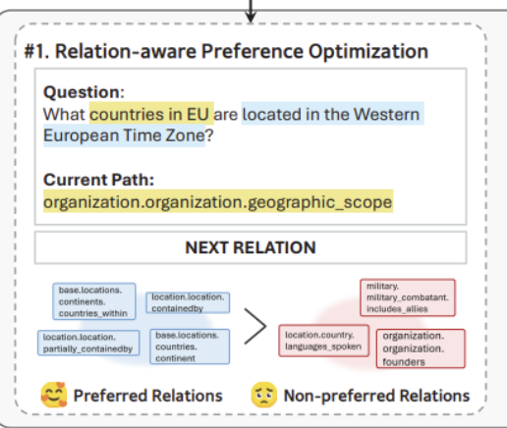
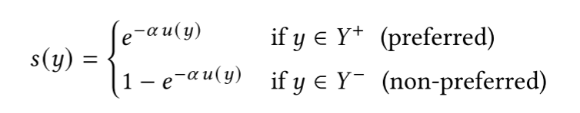

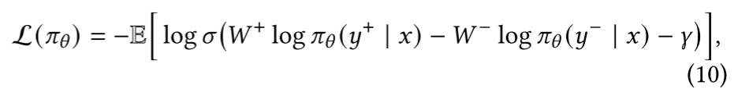
ATAI
Advanced Technique of Artificial Intelligence
ATAI
ChongqingUniversity _{AdvancedTechniqueof}
of Technology Artificial Intelligence
Chongqing University of
Technology
Chongqing University ^{ATAI}
_{of Technology} Advanced Techniqueof
Artificial Intelligence
Chongqing University of Technology
Chongqing University of Technology
Method

Slide 11
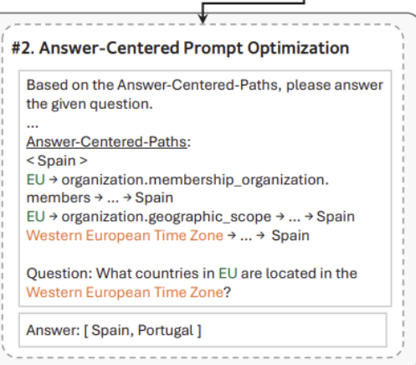
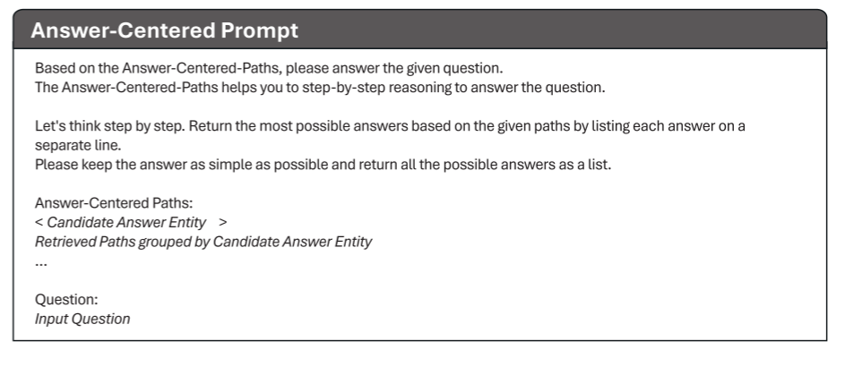

ATAI
Advanced Technique of Artificial Intelligence
ATAI
ChongqingUniversity _{AdvancedTechniqueof}
of Technology Artificial Intelligence
Chongqing University of
Technology
Chongqing University ^{ATAI}
_{of Technology} Advanced Techniqueof
Artificial Intelligence
Chongqing University of Technology
Chongqing University of Technology
Method

Slide 12
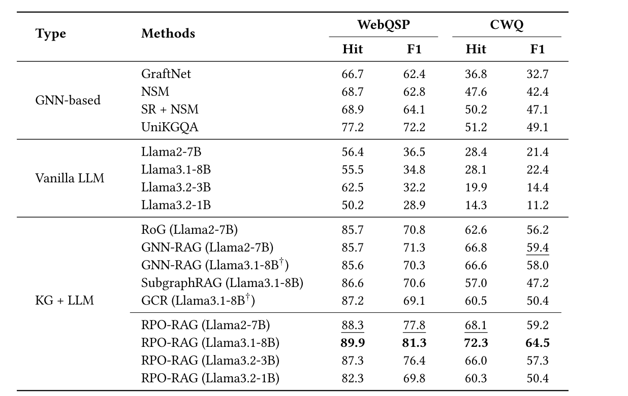
ATAI
Advanced Technique of Artificial Intelligence
ATAI
ChongqingUniversity _{AdvancedTechniqueof}
of Technology Artificial Intelligence
Chongqing University of
Technology
Chongqing University ^{ATAI}
_{of Technology} Advanced Techniqueof
Artificial Intelligence
Chongqing University of Technology
Chongqing University of Technology
Experiments

Slide 13
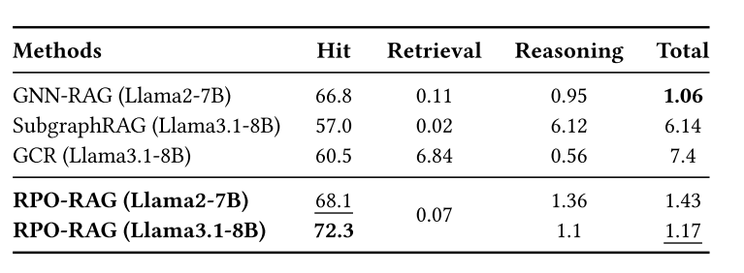
ATAI
Advanced Technique of Artificial Intelligence
ATAI
ChongqingUniversity _{AdvancedTechniqueof}
of Technology Artificial Intelligence
Chongqing University of
Technology
Chongqing University ^{ATAI}
_{of Technology} Advanced Techniqueof
Artificial Intelligence
Chongqing University of Technology
Chongqing University of Technology
Experiments

Slide 14
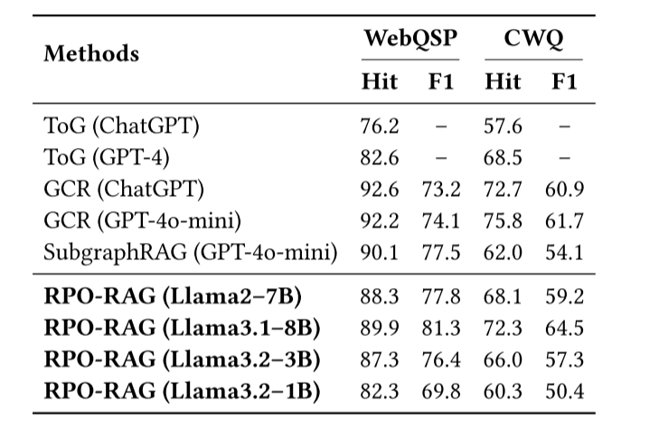
ATAI
Advanced Technique of Artificial Intelligence
ATAI
ChongqingUniversity _{AdvancedTechniqueof}
of Technology Artificial Intelligence
Chongqing University of
Technology
Chongqing University ^{ATAI}
_{of Technology} Advanced Techniqueof
Artificial Intelligence
Chongqing University of Technology
Chongqing University of Technology
Experiments

Slide 15
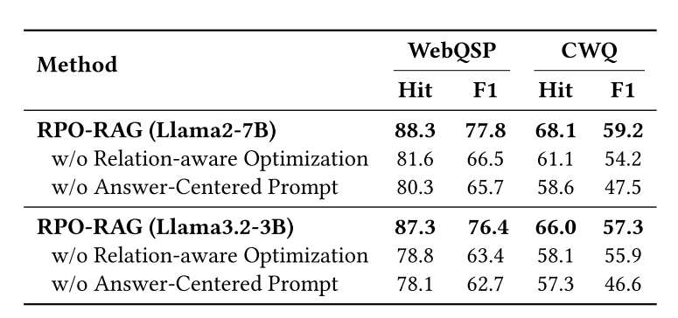
ATAI
Advanced Technique of Artificial Intelligence
ATAI
ChongqingUniversity _{AdvancedTechniqueof}
of Technology Artificial Intelligence
Chongqing University of
Technology
Chongqing University ^{ATAI}
_{of Technology} Advanced Techniqueof
Artificial Intelligence
Chongqing University of Technology
Chongqing University of Technology
Experiments

Slide 16
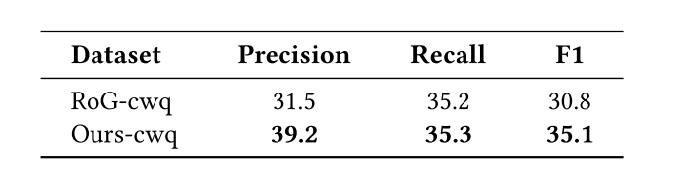
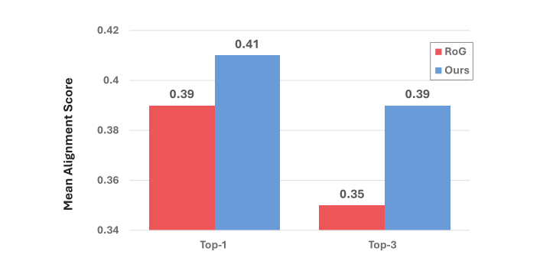
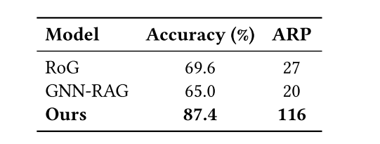
ATAI
Advanced Technique of Artificial Intelligence
ATAI
ChongqingUniversity _{AdvancedTechniqueof}
of Technology Artificial Intelligence
Chongqing University of
Technology
Chongqing University ^{ATAI}
_{of Technology} Advanced Techniqueof
Artificial Intelligence
Chongqing University of Technology
Chongqing University of Technology
Experiments

Slide 17


ATAI
Advanced Technique of Artificial Intelligence
ATAI
ChongqingUniversity _{AdvancedTechniqueof}
of Technology Artificial Intelligence
Chongqing University of
Technology
Chongqing University ^{ATAI}
_{of Technology} Advanced Techniqueof
Artificial Intelligence
Chongqing University of Technology
Chongqing University of Technology
Thanks!

